Slide 1
Structuring narratives -
Writing your own story…
Who?
What?
Where?
When?

Slide 2
Structuring narratives -
Writing your own story…
Learning objectives:
To learn how to structure a plan for a story.
To link to the work of Dylan Thomas.

Slide 3
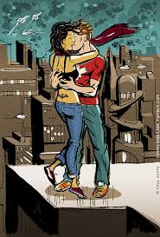
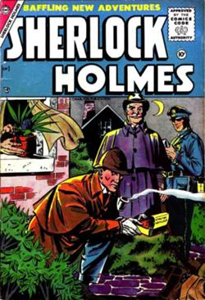
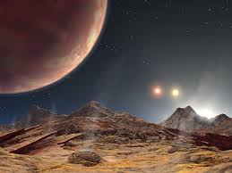
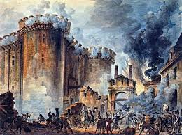
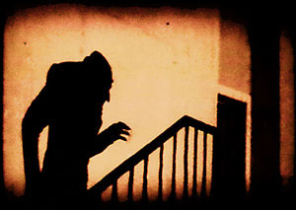
Which genre?
Romance
Crime/detective
Science fiction
Action/Adventure
Horror

Slide 4
Paired Task
Make a list of films that you think fit a specific genre. Be prepared to discuss these with the rest of your class.

Slide 5
Who?
Main Character
Other Characters
Looks?
Character?
Personality?
Mood?
Who are they?
How do they relate to the main character?
What is interesting about them?

Slide 6
What?
Beginning | Middle | End
What sort of things should you introduce here? Main character Setting Hint towards the problem | What should you develop here? The problem Change in setting Other characters Tension As bad as it can be | How should you finish things off? Problem solved Return to the first setting Things are back to normal

Slide 7
Use descriptive language
If you are saying something is “big”, why not describe it as “enormous” or “gigantic”?
A beautiful thing could be described as being “incredibly beautiful” or “absolutely stunning”.
If you want to describe something as “scary”, you could say it was “utterly terrifying”, or “extremely scary”, or even, “petrifying”!
Make good word selections!

Slide 8
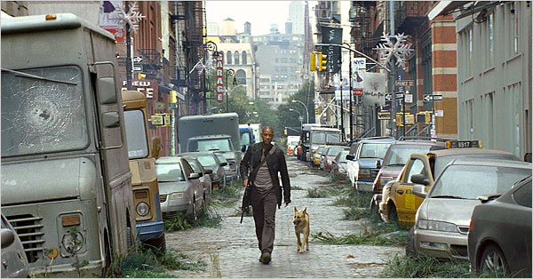
Where? When?
Try to be specific and describe clearly the place and time that events take place. Create suspense!
As he roamed the city alone in daylight it struck him how busy this place once was. He had been to this place at the same time a year ago and couldn’t move through the crowds. The crowds had gone.
“If you are out there... if anyone is out there... I can provide food, I can provide shelter, I can provide security. If there's anybody out there... anybody... please. ”

Slide 9
Plan, plan, plan
Genre
Characters
Who, what, where, when?
Beginning, middle and end
Descriptions

Slide 10
‘Peaches’ by Dylan Thomas
Read the opening to ‘Peaches’ by Dylan Thomas
Can you guess what genre it is?
Look at the way Uncle Jim is described. Is it effective characterisation?
Look at the way that Thomas uses descriptive writing in the opening. How effective do you think it is?

Slide 11
Themes
Write a story on one of the following themes:
Courage
Family
Life
Love
Travel
Relationships

Slide 12
My Story – Checklist
Punctuation Full stops, commas, question marks and exclamation marks.
Capital letters Do all my sentences start with a capital letter?
Sentences Do they all make sense?
Adjectives Have you used adjectives to make your story more interesting?
Read your story Does it make sense?

