Slide 1
The Hunchback in the Park

Slide 2
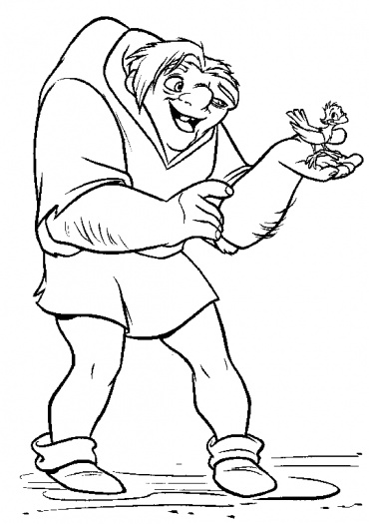
Quasimodo
What do you think of this image?
What personality traits do you think this character has?

Slide 3
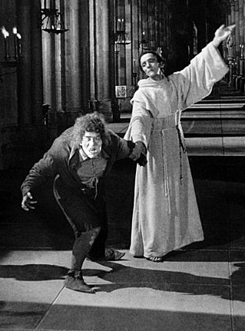
Notre-Dame Cathedral, Paris
How is this image
different?
What impression do you
get of the main character here?
What impact do the surroundings have?

Slide 4
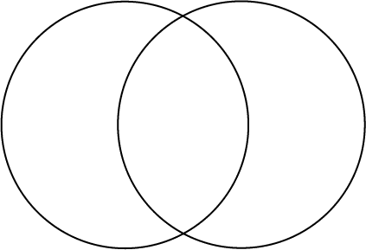
Venn diagram
Consider what the similarities and differences are between both images. Also think about how their lives would differ.

Slide 5
Now read the poem...
What does it make you think about?
What images stand out on your first reading?
What do you notice about the form and structure of the poem?
Make notes on your first impressions.

Slide 6
Look at the following line from the first stanza:
‘A solitary mister’ (line 2)
CONSIDER:
What words in particular in these lines say something about the hunchback?
Look at the words ‘solitary’ and ‘alone’ and think about how these show the hunchback’s isolation from the rest of society.
His disability marks him out as different and he appears an outcast amongst his fellow men.

Slide 7
Look at the word ‘mister.’ What does this word suggest? Where is it used again and by whom?
Does the word ‘mister’ suggest respect or something else? What do you think?

Slide 8
‘From the opening of the garden lock
That lets the trees and water enter’
The above are lines 4 and 5 in the opening stanza.
In pairs:
Look at the way that the poet uses the connotations of the word ‘lock.’
What types of lock are there and what is Thomas saying in these lines?

Slide 9
Exemplar analysis:
Thomas carefully plays with the idea of a ‘lock’ in these lines. He uses ‘lock’ in the sense of lock and key as the park is locked after the bell has been rung for the night. Thomas also uses ‘lock’ in the sense of a canal lock which lets water in and out to allow barges to move up and down the canal freely.
His image is highly inventive as it suggests that the park only starts to awake when the lock is opened and the ‘trees and water enter’. It is as though he is interpreting their entrance like actors or players on a stage. This reflects his artistic and creative mind clearly in the opening stanza.

Slide 10
Alliteration…how and why it is used?
Analysis: Do it Yourself!
‘Until the Sunday sombre bell at dark’
In pairs consider:
What is the effect of the alliterative ‘s’ sound in line 6 of
the poem?
What kind of feeling does it give this part of the poem
and why?

Slide 11
Exemplar Response
The alliteration of the ‘s’ sound highlights the sadness of the fact that the hunchback lives and sleeps in the confines of the park. The alliterative ‘s’ sound is also reminiscent of the sound of a deep resonant bell sounding bringing the sound to life in the poem.
The use of the word ‘sombre’ is effective as it brings a solemn tone to the poem and, in turn, to the life of the hunchback.

Slide 12
The essentials of life: Stanza 2
“Eating bread from a newspaper”
“Drinking water from the chained cup”
“Slept at night in a dog kennel”

Slide 13
Discussion Task: The Essentials
Look at stanza 2 at what the hunchback eats, drinks and where he sleeps and finds shelter.
What does this show about him as a character in the poem?

Slide 14
Exemplar Response:
The poet emphasises the three basic essentials for life by placing the verbs ‘Eating,’ ‘Drinking’ and ‘Slept’ at the beginning of the lines in the second stanza. The nouns he places after these verbs are used to shock and surprise the reader as the hunchback only has ‘bread’ and ‘water’ to sustain him as these can only be described as the most basic of rations. Also he sleeps in a ‘dog kennel.’ This shows that the hunchback lives a hand to mouth existence and is presented and viewed as little more than an animal; one step up from a dog.

Slide 15
Thomas’ Language Choice: Connotation
Drinking water from a chained cup’
Paired Task
The poet has purposely included the imagery of being restricted with ‘chained cup.’
Why do you think the poet chose to include this image particularly?

Slide 16
Task
Consider what image is presented of the hunchback here and how the poet makes it more effective through the connotation of the word ‘chained’.

Slide 17
Peer Assessment
Exchange answers and give your peer formative assessment on their answer.
Note down two positives and one aspect that they could develop.
Re-write your response using the feedback as stimulus.

Slide 18
Exemplar Response
The word choice draws the reader’s attention to the fact that the hunchback does not own his own cup. This suggests that his belongings and his life are very limited. He does not own a plate as he eats his bread from ‘newspaper.’ The man’s poverty is highlighted by the restriction “chained cup”. The ‘c’ and ‘ch’ sounds are presented quite harshly and therefore makes his situation more dire and draws on the empathy of the reader. The man is presented as poor as we learn that he has to drink from a fountain where the narrator (the ‘I’ of the poem) ‘sailed [his] ship.

Slide 19
Exemplar Response Continued
This shows the poor man has literally and metaphorically stooped low as he is reduced to drinking from a fountain. His constraint and isolation are also linked to the word ‘chained’, as poverty can feel like a form of imprisonment as you do not have the freedom to go and do what you like as you cannot afford it. The hunchback takes pleasure from being in the park because it enables him to enjoy something for free; the park is available to everyone.

Slide 20
“But nobody chained him up”
The poet states here that the hunchback sleeps in a dog kennel. When a dog is in a kennel they are generally chained up to stop them running away or attacking other animals.
Discussion Task
What do you think is being suggested in this line?

Slide 21
‘chained’
The line could suggest that there was no need to chain the hunchback up because he was already metaphorically ‘chained’ by his poverty and society as his freedom was limited by what he could afford, or not afford to do.
He could also be metaphorically shackled or ‘chained’ by his deformity/ disability.

Slide 22
Simile: why is it used?
‘Like the birds he came early
Like the water he sat down’
Consider:
Why do you think the hunchback comes early?
Does water sit down?
How is this an effective image of the hunchback?

Slide 23
What is the purpose of the simile use?
The hunchback comes early to the park because he enjoys its beauty. The natural beauty of the park is in contrast to the degradation of his sleeping accommodation – the dog kennel. He comes early to get a good spot and to feel that he belongs there.
When water sits on the ground, it is often unwanted as it suggests flooding and puddles.
The hunchback can be seen to be as natural as water sitting on the ground but as unwanted as flood water which makes this an effective simile in showing the hunchback’s alienation from the rest of society. He does not fit in and is not wanted.

Slide 24
‘truant boys’
Discussion Task:
What does the word ‘truant’ mean?
Why is it used as an adjective to describe the boys in the park?
What does it suggest about what they are doing in the park and what their behaviour might be?

Slide 25
Definition: ‘truant’ is a noun to describe a person who is absent without leave, especially from school. It can also be an adjective of being or relating to a truant.
What behaviour would you expect of someone who truants and why? Is the expectation of bad behaviour justified in this poem?

Slide 26
‘Running when he has heard them clearly
On out of sound’
In pairs discuss the following:
What do you think the word ‘clearly’ suggests about the boys’ reasons for yelling at the man?
Think about the type of image of the boys that is being presented in the line.

Slide 27
Possible readings…
The word ‘Clearly’ suggests that the boys wanted the man to hear their jeering and they did not run away until they were sure that he had heard them. It is an act of boasting and bravado on the boys’ parts. They want to appear brave calling the hunchback names but are not brave enough to face the significances, instead ‘running’ away.
There is effective use of imagery in the line where the boys are described as running ‘out of sound’ and not ‘out of sight.’ This could suggest that they run far enough away so that the hunchback’s response is not audible or they run away until the sound of their feet and their taunts can no longer be heard.

Slide 28
Written Task 1
Do you think Thomas is presenting the boys as bullies, cowards or heroes?
In your response consider the way that the hunchback, the park keeper and the boys themselves view the situation. Find evidence from the text to support your viewpoint.

Slide 29
Written Task 2
How effective is the poet in presenting the hunchback in his poem as an artist?
In your response, consider the poet’s view that poetry is an art form. How artistic is he in painting the image of the hunchback in the poem? Think about the links to religion, the other characters in the poem and his use of imagination.

