Slide 1
Lesson 1 – Overview
By the end of this lesson, I will:
Have an understanding of the poem’s background and its general content.

Slide 2
Lesson 1 Starter
Look at these words from the poem.
Can you work out what the poem is about?
Which words provide the best clues?
darkness / silence / the last light / the still hour /
the shadow of a sound / mourn / a grave truth / majesty and burning / innocence and youth /
deep / London’s daughter / unmourning water

Slide 3
Lesson 1 Resource Sheet Task 1
In pairs:
This is a poem about the death of a child. What would you expect the title to be?

Slide 4
Lesson 1 Resource Sheet Task 2
The title of the poem is:
‘A Refusal to Mourn the Death, by Fire, of a Child in London’
Write it out on the top of your resource sheet
How do you respond to the title?
Is the title of the poem unexpected? Why/Why not?

Slide 5
Title of poem
‘A Refusal to Mourn the Death, by Fire, of a Child in London’ by Dylan Thomas, was written and first published in 1945.
Does the date 1945 help with our understanding of the background of the poem?

Slide 6
London during WW2
London was heavily bombed during the Second World War.
The Blitz – London attacked over 70 times from September 1940 to May 1941.
V-1 flying bombs and V-2 rockets (1944-45)
Map of bombs which fell over London: http://bombsight.org/#10/51.4788/0.0240
Tens of thousands lost their lives.

Slide 7
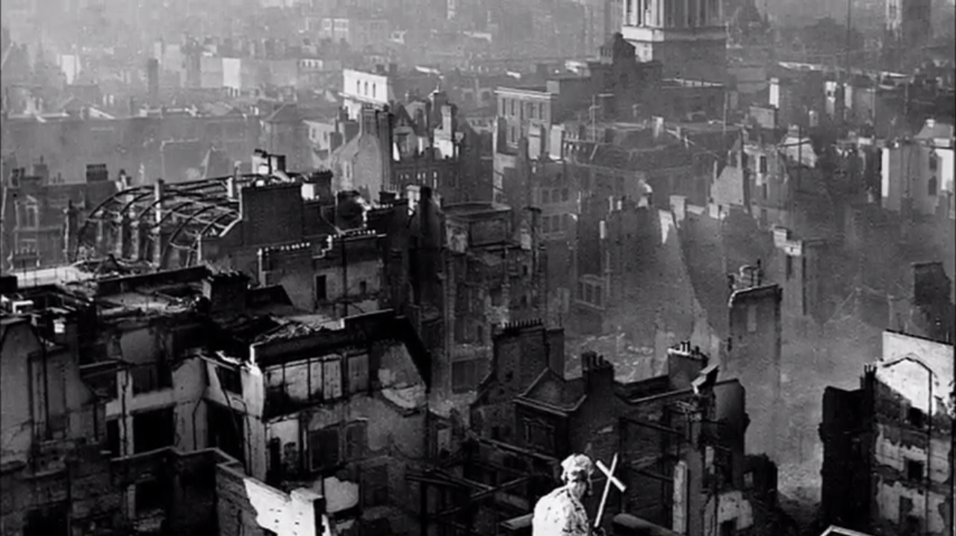
London during Blitz

Slide 8
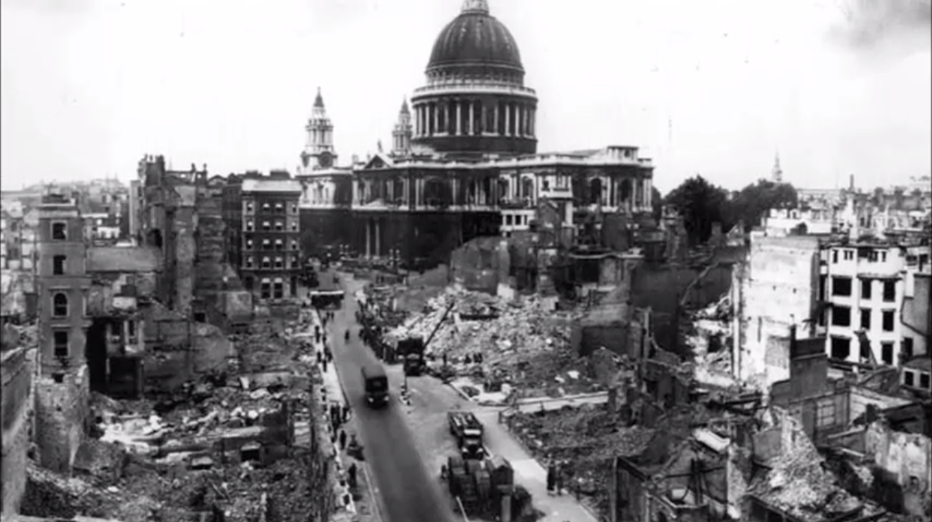
London during Blitz

Slide 9
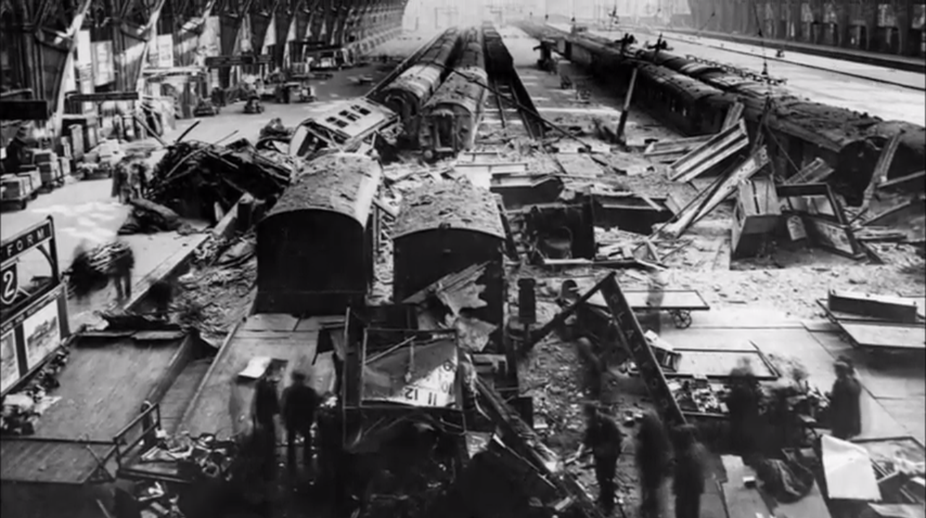
London during Blitz

Slide 10
Listen to the poem being read
Here is a recording of Dylan Thomas reading of ‘A Refusal to Mourn the Death, by Fire, of a Child in London’:
http://www.youtube.com/watch?v=6B2c4b23r3k
What are your impressions of the reading?

Slide 11
Lesson 1 Resource Sheet Task 3
In pairs, scan the poem to answer these questions.
How many sentences does the poem contain?
How many lines of the poem does each sentence cover?
What is the effect of having a long sentence and other shorter sentences?

