Slide 1
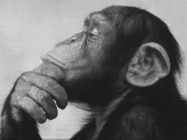
Doing Philosophy
Lesson 1

Slide 2
What is a philosophical question?
Is it:
Something we can find the answer on by researching and looking it up on Google?
A question that may lead to further questions and there is no right or wrong answer?

Slide 3
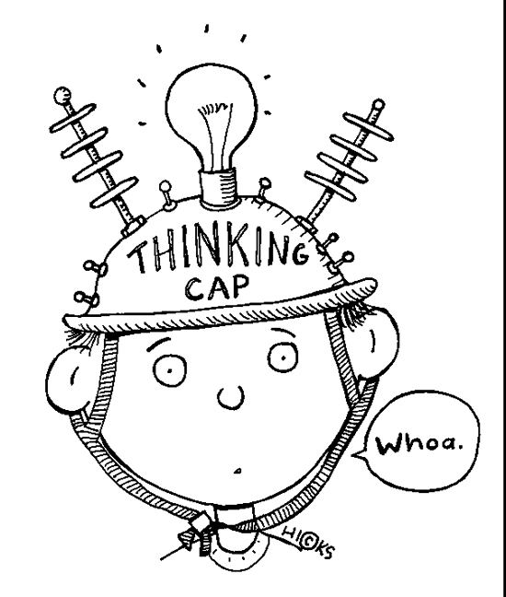
Today, we are aiming to:
take part in discussions as part of a
community of enquiry;
to think of our own questions and decide for
ourselves what we will discuss;
reach some conclusions and reflect on our own
views and those of others.
Notes:
3

Slide 4
Rules for P4C
Listen to everyone and never talk when someone else is talking.
Put your thumb up in the circle to speak.
Listen to everyone’s opinion.
Respect and treat others the way you would like to be treated.
What is discussed is to stay in the classroom.
Respect all points of view.

Slide 5
Begin your discussion by considering whether you believe lying is acceptable or can be acceptable in certain situations.

Slide 6




Stars
Write the colour star you feel is most appropriate on the post-it note.
Gold Star – I feel like the discussion went very well and that I have learnt new ideas on the topic.
Silver Star – I feel like I contributed well to the discussion and really listened fully to people’s opinion and have developed a new way of understanding the topic.
Blue Star – I still have mixed feelings about this topic. I have a lot more questions that I could ask on this topic.
Red Star – My opinion has changed since having the discussion.

Slide 7
Doing Philosophy
Lesson 2

Slide 8
Consider your findings from last lesson and consider whether you think Dylan Thomas is a potential figure that children could look up to. Consider biographical information that you know about his life.

