Slide 1
Under Milk Wood
A ‘play for voices’ by Dylan Thomas

Slide 2
UNDER MILK WOOD
The poet, Dylan Thomas finished writing the play on his last visit to New York, in 1953, having worked on it for several years.
First performed on the BBC in January 1954.

Slide 3
Task
Look at the following posters for Under Milk Wood.
Based on the image, what do you think the play might contain or be about?
Look carefully at the setting, time and characters.

Slide 4
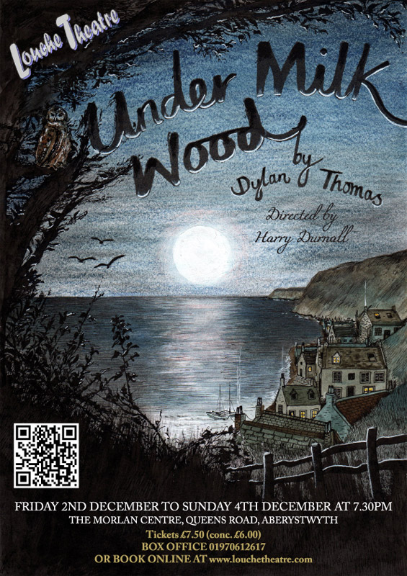
Credit: Emily Wallis
www.emilywallis.com

Slide 5
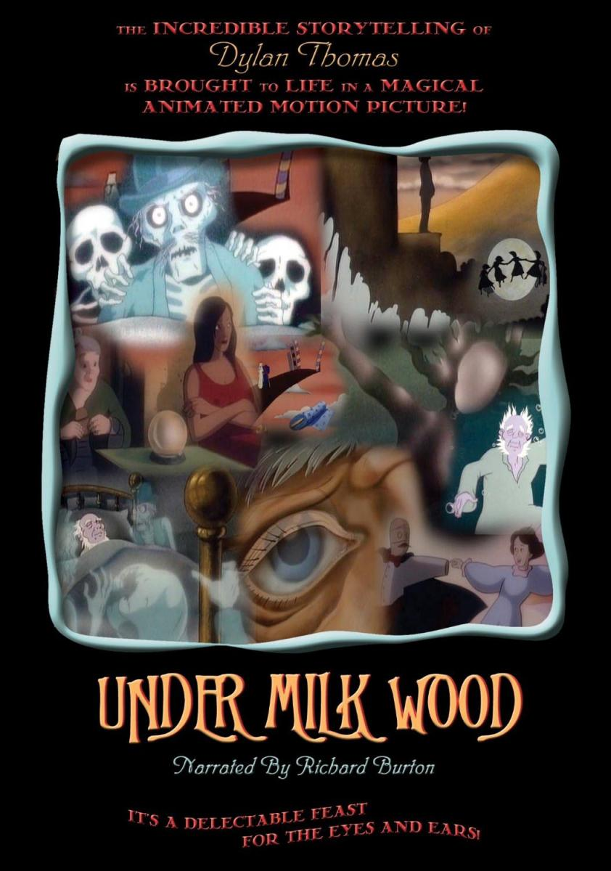

Slide 6
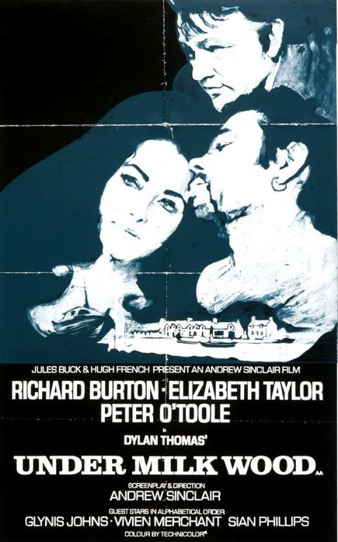

Slide 7
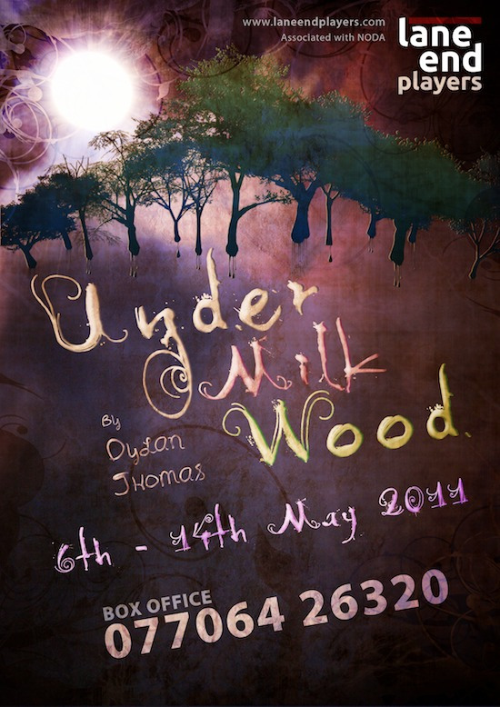

Slide 8
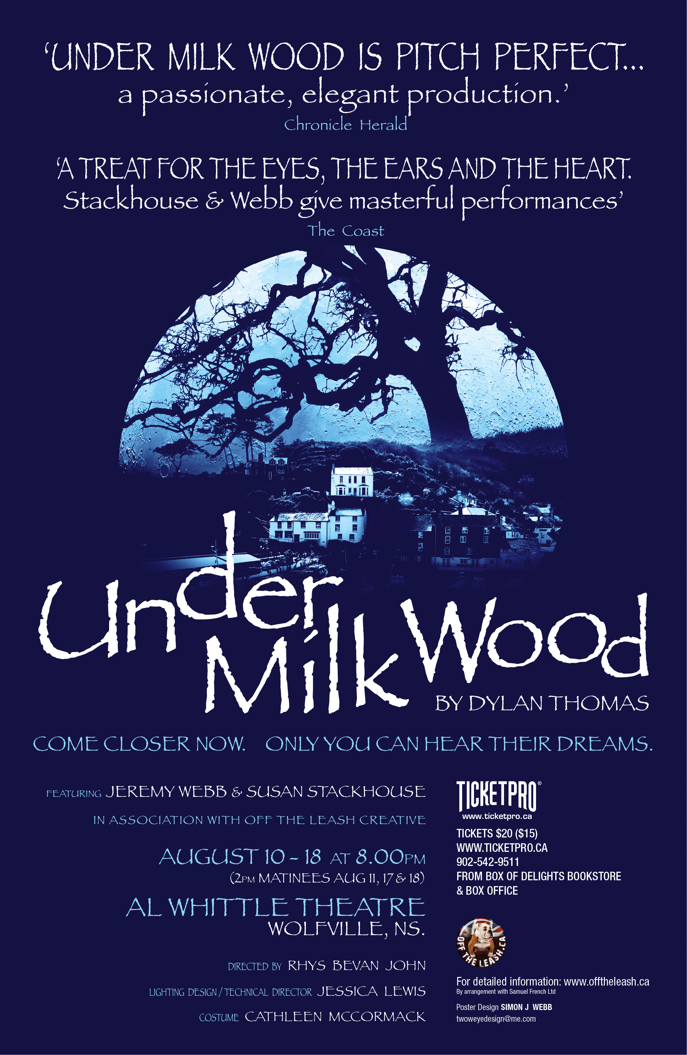
Credit - Poster Design by Simon J. Webb
for Off The Leash Creative Ltd
www.offtheleash.ca

Slide 9
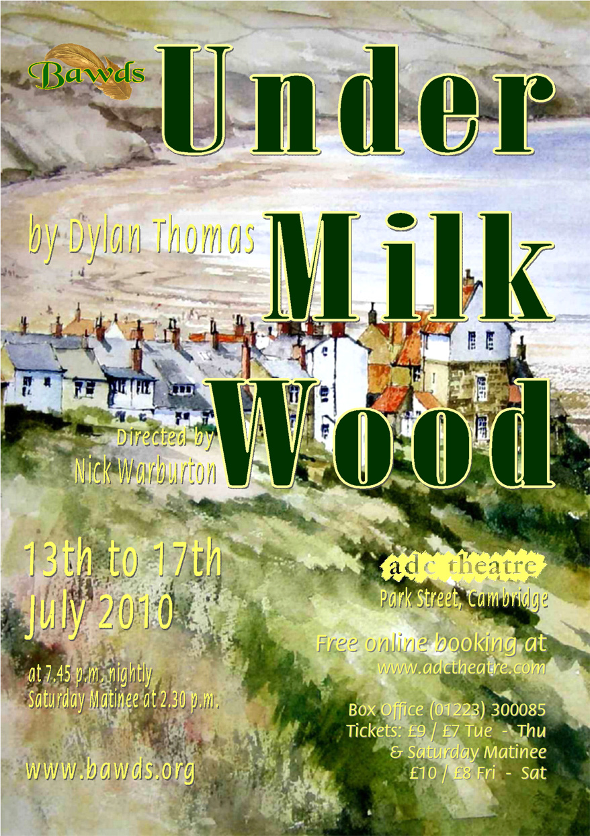

Slide 10
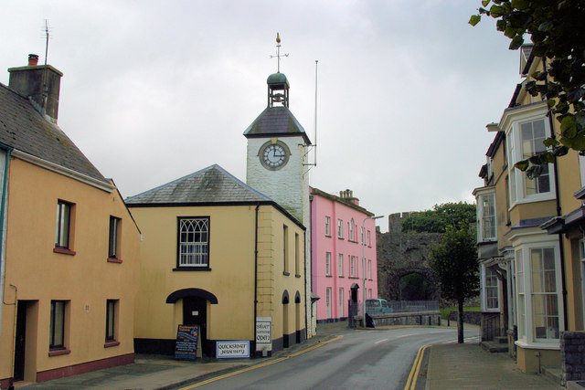
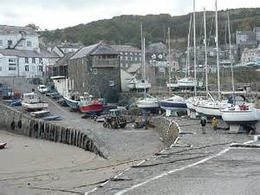
The Town
Set in a fictional seaside town called ‘Llareggub’ (read it backwards to get the joke!)
Many believe that the location is based on the village of Laugharne, in Carmarthenshire and New Quay, Ceredigion where Dylan spent much time.
Left: Photo of Laugharne by Stuart Logan.
Right: Photo of New Quay by Ruth Jowett.
www.geograph.org.uk

Slide 11
The Characters
“...the farmers, the fishers, the tradesmen and pensioners, cobbler, school-teacher, postman and publican, the undertaker and the fancy woman, drunkard, dressmaker, preacher, policeman, the webfoot cocklewomen and the tidy wives...” – the play shows us the town waking in the morning and the variety of characters who live and have lived in Llareggub.
Blind Captain Cat is the central character who sees his dead friends in his dreams.

Slide 12
The play follows the lives of the various townfolk, and invites the audience to listen in on their daily duties, their dreams and memories, and secrets.
We also get an insight into the humorous relationships they have with each other.

Slide 13
There are several famous recordings of the play, and it has also been made into a film.
Richard Burton and Anthony Hopkins have performed it.
‘Under Milk Wood’ inspires new art all the time.
Here’s work in progress on the internet
Animation by Youtuber Jessica xyl
Voice of Anthony Hopkins

