Slide 1
Dylan Thomas
Lesson 3 – The characters of ‘Under Milk Wood’

Slide 2
Under Milk Wood
In this lesson we are going to learn about the characters in ‘Under Milk Wood’.
We are going to create our own characters.

Slide 3
Under Milk Wood
‘Under Milk Wood’ is Dylan Thomas’ most famous work.
He described it as a dramatic poem.
It was broadcast on radio as a drama.
It describes a day in a Welsh village in the last century.

Slide 4
Under Milk Wood
There are many funny characters in ‘Under Milk Wood’.
Dylan Thomas gives them names which match their character.
Let’s take a look at some of them.

Slide 5
Nogood Boyo
Nogood Boyo is a very lazy fisherman.
At night, he dreams of nothing!

Slide 6
Lord Cut-Glass
Lord Cut-Glass has sixty six clocks in his kitchen!
There is one clock for each year he has lived.
At night, he dreams of all the clocks in his kitchen.

Slide 7
Organ Morgan
Organ Morgan is the church organ player.
At night, he dreams of music and orchestras in the village.

Slide 8
Character
Let’s create our own character!
Choose a picture of a person from a magazine or the internet.

Slide 9
Character – Ask questions
Look at the character and get your partner to ask questions about the character, e.g.
  How old are they?
  Where do they live?
  What are they interested in?
  Do they have anything they really dislike?
  Have they a special talent?
  Do they have a secret?
  What are they afraid of?
  What is their biggest wish?
You won’t know the answer, so you’ll have to make them up!

Slide 10
Character – What do they look like?
Think of adjectives to describe your character.
How would you describe
  how they look?
  what they are wearing?
  their hair?
  Try and use powerful words!

Slide 11
Character - How do they feel?
How do you think your character feels?
Why do you think they feel like this?
Again – you’ll have to make up answers for these questions!

Slide 12
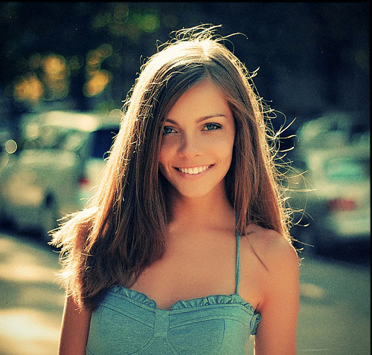
Here’s an example
This is Eiry Matthews. She is a teacher in Aberystwyth. She has long brown hair, blue eyes and is very fit. She likes going to the beach and loves to swim in the sea. She likes eating healthy food but hates chips.
She’s very happy now because she’s seen her son, Dafydd. He got lost when he wandered off to find crabs in the rock pools.

Slide 13
Character - Write a description
Using the words and ideas you have discussed, write a description of your character.
Remember to use correct punctuation when you write.

