Slide 1
Dylan Thomas
Lesson 1 – The language of ‘Under Milk Wood’

Slide 2
Under Milk Wood
In this lesson we are going to learn about Dylan Thomas and his play ‘Under Milk Wood’.
We will also get the chance to play with words and create tongue-twisters.

Slide 3
Dylan Thomas
Dylan Thomas was a poet.
He wrote about his life, friends and about Wales.
Some poems are serious, some are funny.
He was born in 1914 and his first home was in Swansea, South Wales.

Slide 4
Under Milk Wood
‘Under Milk Wood’ is Dylan Thomas’ most famous work
He described it as a dramatic poem.
It was broadcast on radio as a drama.
Listen to the opening of the work.
There may be a lot of words you don’t understand - don’t worry about this, but just listen to the sound of the words.

Slide 5
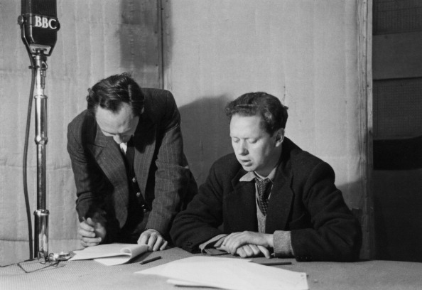
Under Milk Wood
http://www.youtube.com/watch?v=uuPO2Kvqlms

Slide 6
Under Milk Wood
Do you think that the opening sounded like a poem or a play? Why?
Dylan Thomas is describing a Welsh village. What time is it in the village?
Dylan Thomas liked playing with words. Did you hear rhyming words in the piece? What were they?

Slide 7
The sounds of words
The sound of words was important to Dylan Thomas.
Do you like the sound of ‘fishingboat-bobbing sea’?
Which sound do you hear a lot of in those words?
Can you say it quickly?

Slide 8
Tounge-Twisters
Words or sentences that are hard to say are called tongue-twisters
Can you say these?
  Red lorry, yellow lorry.
  Peter picked a peck of pickled peppers.
  She sells seashells by the sea shore.
  Freshly fried flying fish.
  Which wristwatches are Swiss wristwatches?

Slide 9
Tongue-twisters
A lot of tongue twisters have words beginning with the same letter – this is called alliteration.
Can you think of examples of alliteration?
  e.g. Gareth’s green goblin

Slide 10
Tongue-twisters
In groups, have a go at making your own tongue-twisters.
After you finish, swap with another group to see if you can say each other’s tongue-twisters.

